Slide 1
BRITISH AIRWAYS
PREDICTING CUSTOMER BUYING BEHAVIOUR
21-08-2023

Slide 2
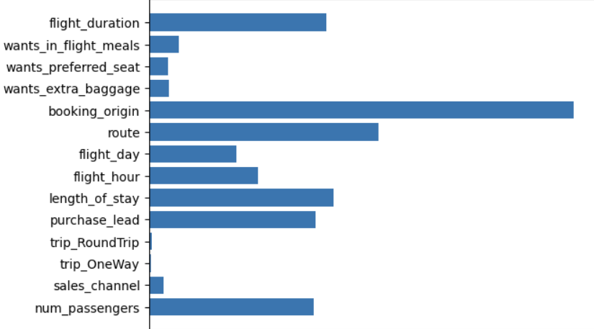
MODEL TO PREDICT WHICH FACTORS INFLUENCE CUSTOMER BUYING BEHAVIOUR
Based on the Dataset provided for customer bookings and I build an ML model using Random Forest Classifier.
The model is evaluated using Metrics - F1 score and Cross validation score.
F1_score = 0.399256
Cross validation score = 0.929780
The Top 6 Important Features of the Dataset are:
1.booking_origin
2.route
3.length_of_stay
4.purchase_lead
5.num_passengers
6.flight_hour

